Slide 1

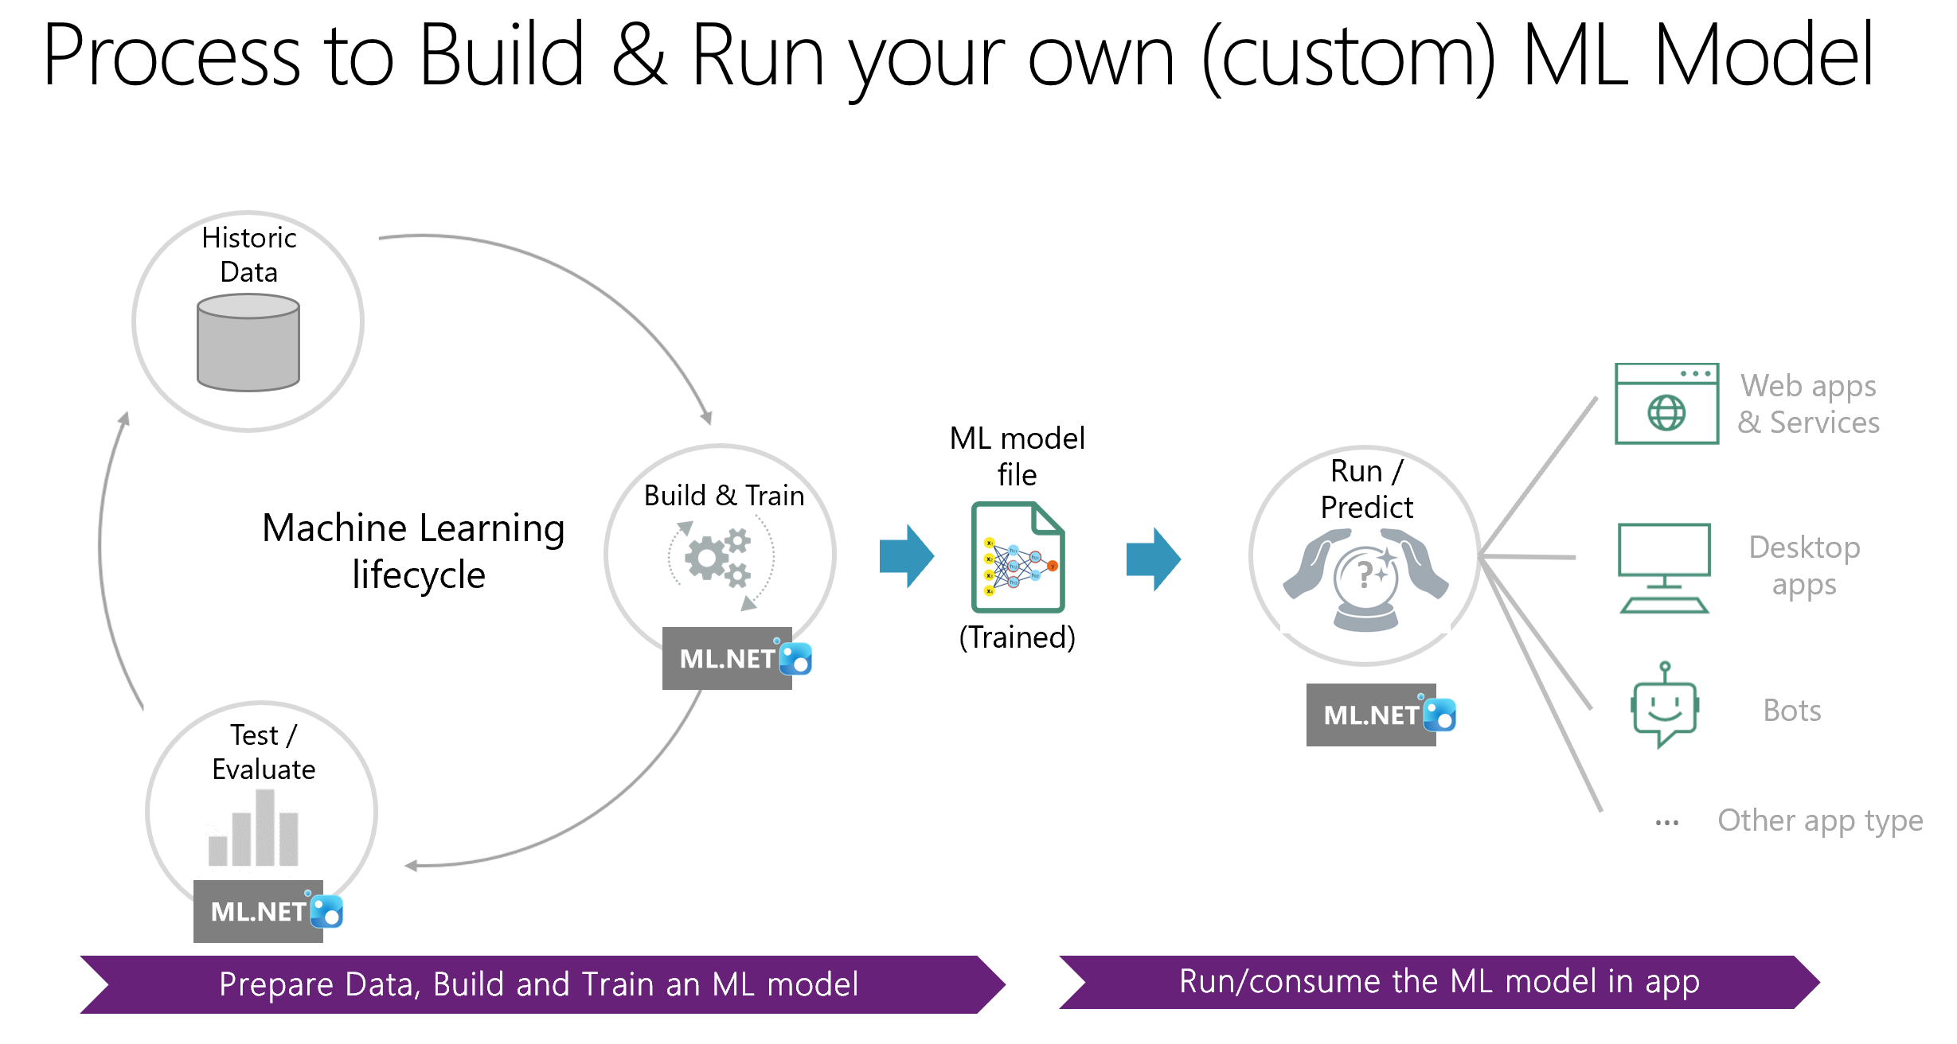

Slide 2



API
CLI
UI
C# / F#
ML.NET CLI
UI
Model Builder
in Visual Studio
IDataView
Trainers
Transforms
AutoML
Extensions
(TensorFlow, ONNX, etc.)
ML.NET API
.NET Core
.NET Framework
Frameworks
Windows
Linux
macOS
OS
x64
x86
Hardware

Slide 3
API
CLI
UI
C# / F#
ML.NET CLI
UI
Model Builder
in Visual Studio
IDataView
Trainers
Transforms
AutoML
Extensions
(TensorFlow, ONNX, etc.)
ML.NET API

Slide 4
Client-side
Server-side
- Desktop app
- Console app
- WPF / WinForms
- Console app
ML.NET 1.0
ASP.NET Core / Fx
Razor, MVC, WebForms
Web app (server-side)
ML.NET 1.0
Web app (Blazor)
(*) ML.NET on Client or Server
Blazor (Client .NET)
(WebAssembly)
ASP.NET Core
ML.NET 1.0
ML.NET 1.0
ASP.NET Core
WebAPI
N-Tier app
Client
Front-end
(Any technology)
ML.NET 1.0
Microservice
Microservice
Microservices app
Client
Front-end
(Any technology)
ML.NET
ML.NET
Microservice
Microservice
ML.NET
Other

Slide 5





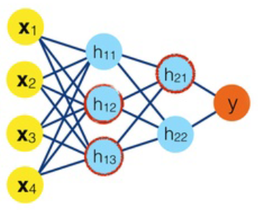



Process to Build & Run your own (custom) ML Model
Historic
Data
Web apps & Services
ML model
file
Run /
Predict
Build & Train
Machine Learning
lifecycle
?
Desktop apps
ML.NET
(Trained)
ML.NET
Bots
Test /
Evaluate
…
Other app type
ML.NET
Prepare Data, Build and Train an ML model
Run/consume the ML model in app

Slide 6


ML.NET components
API for:
NuGet
Build & Train ML.NET models
Run any model
Transforms
Trainers
Misc.
Extensions
Text featurization
Linear
AutoML
Schema
Boosted Trees
CLI
Missing values
Svm
IDataView
Categorical
K-Means
Data loaders
Normalization
…
Model explainability
…
…
Notes:
(16)
The ML.NET comes pre-packaged with developer friendly APIs for Machine Learning both for model training and consumption scenarios.
ML.NET is being launched as a part of the .NET Foundation and the repo today contains the .NET C# API(s) for both model training and consumption, along with a variety of transforms and learners required for many popular ML tasks like regression and classification.
ML.NET is aimed at providing the E2E workflow for infusing ML into .NET apps which includes preprocessing, feature engineering, modeling, evaluation and operationalization.
ML.NET comes with support for types and runtime for all aspects of machine learning which include core data types, extensible pipelines, high performance math, data structures for heterogeneous data, tooling support and more.
Lastly, another value prop that ML.NET provides is that it is fully extensible, which means in time ML.NET will also allow you to leverage other popular libraries like Accord.NET, CNTK and TensorFlow through the same set of APIs.
This will also allow you to compose training pipelines where you will be able to pick the learners that work best for your ML task across a rich set of ML libraries giving you the best of both worlds.

Slide 7
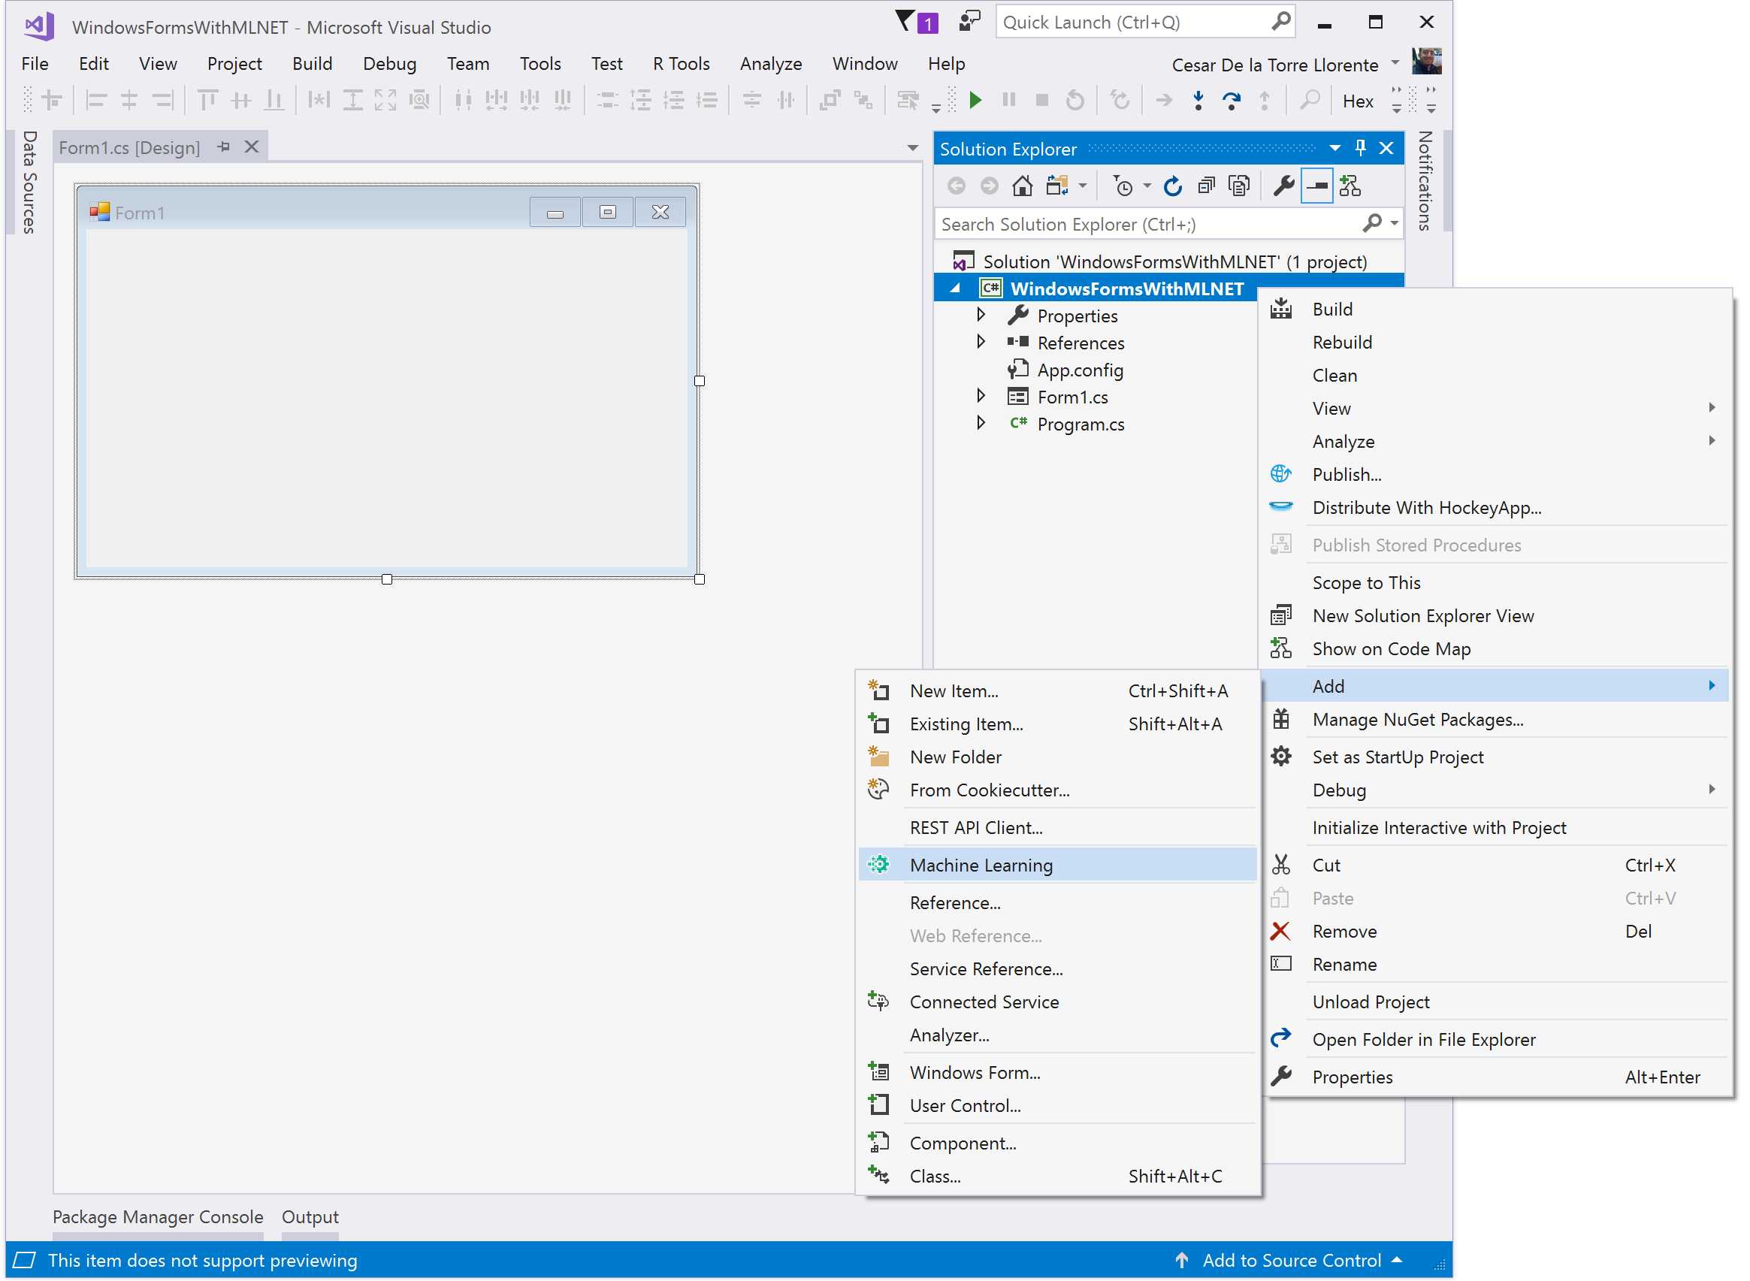
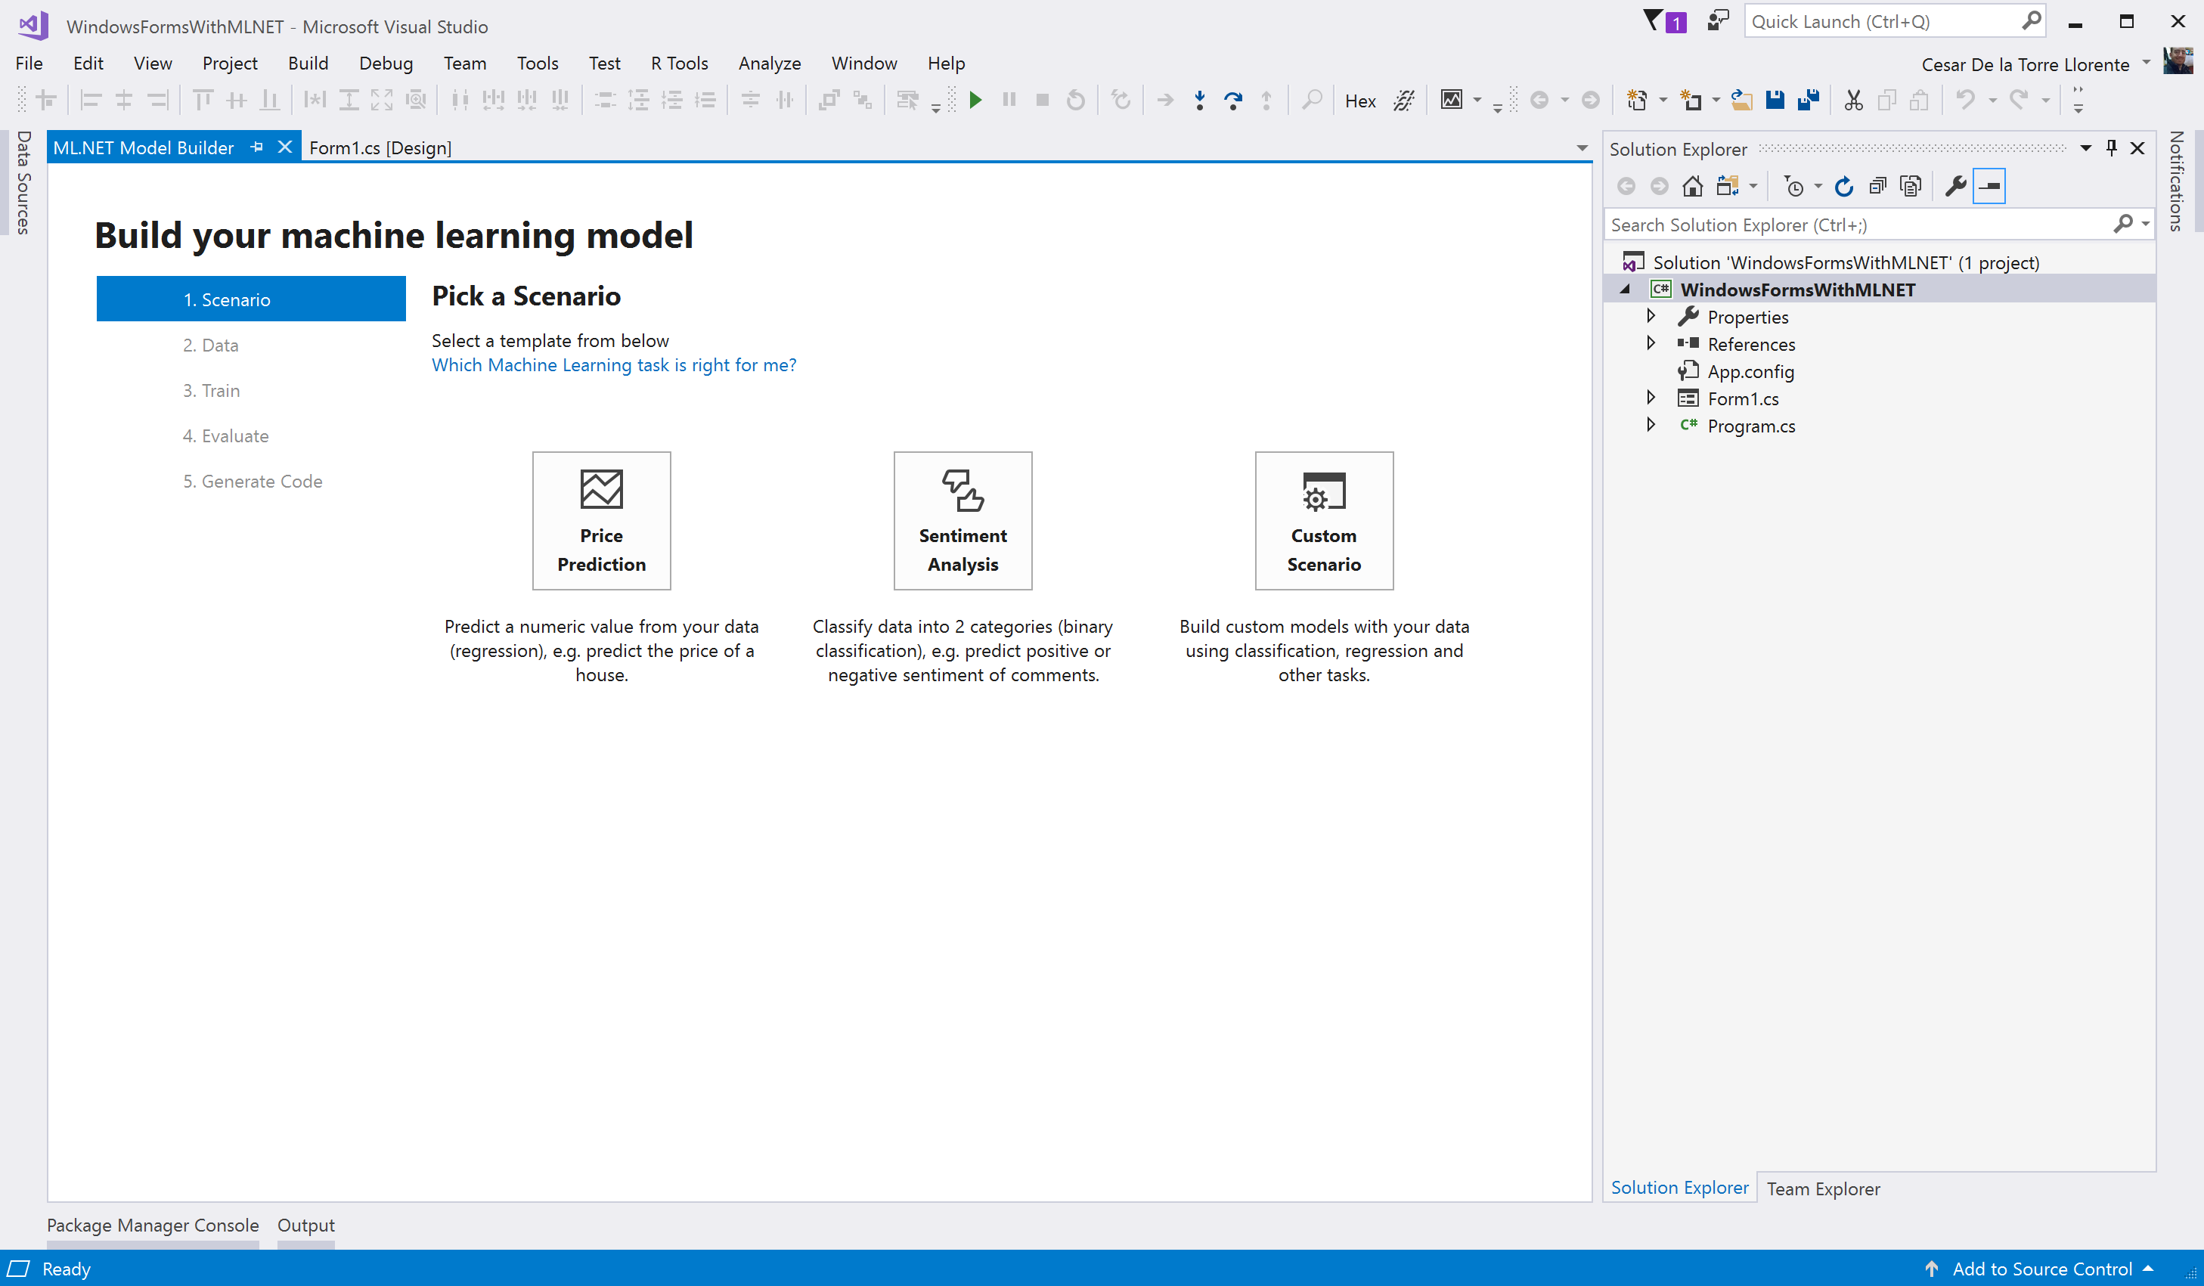
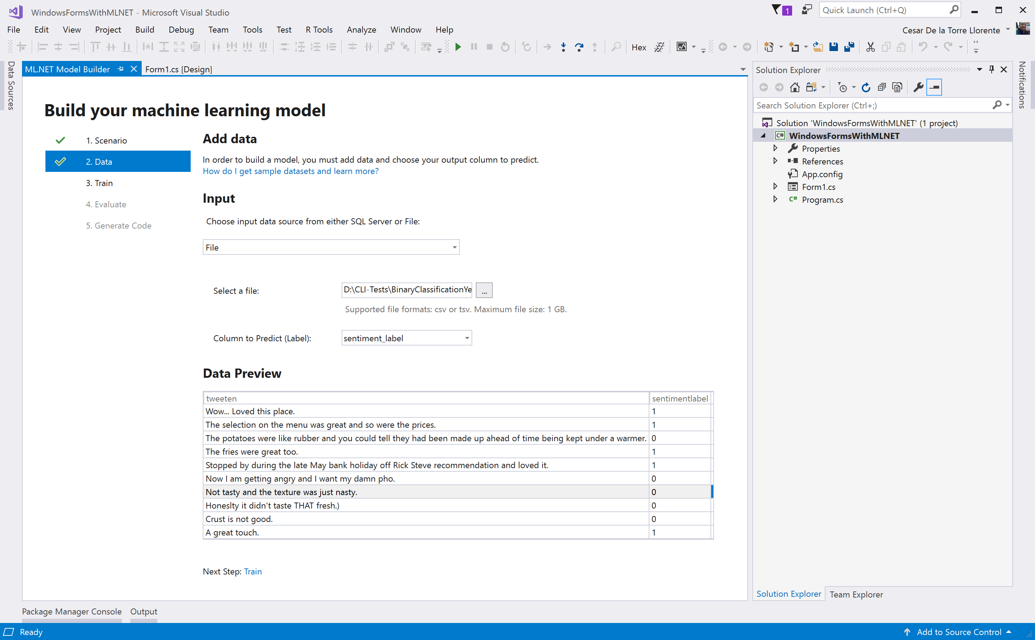
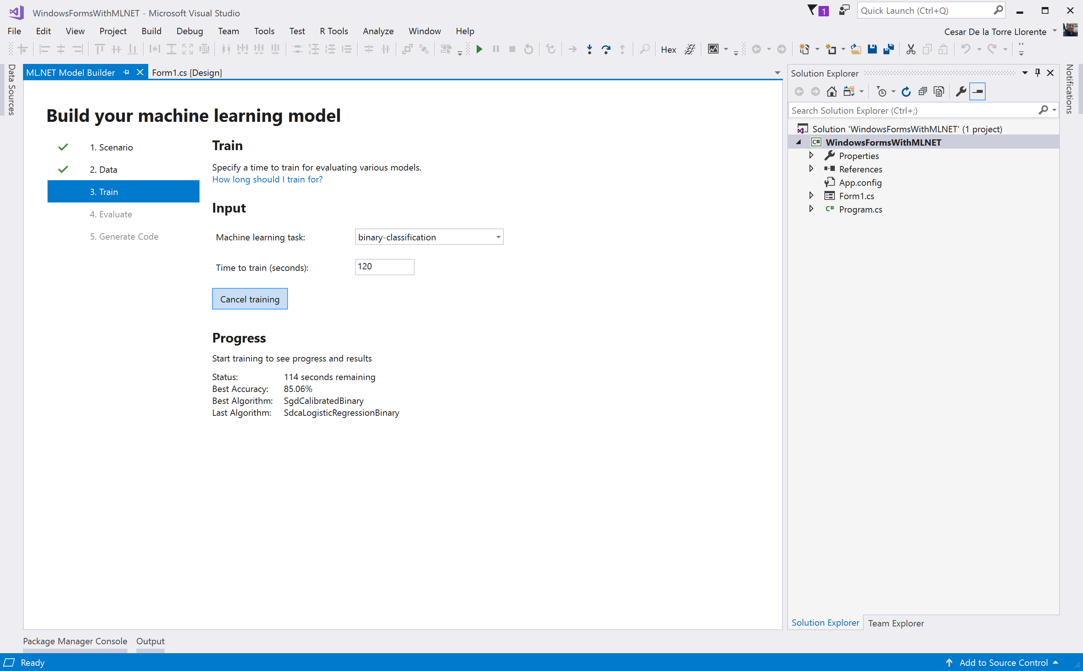
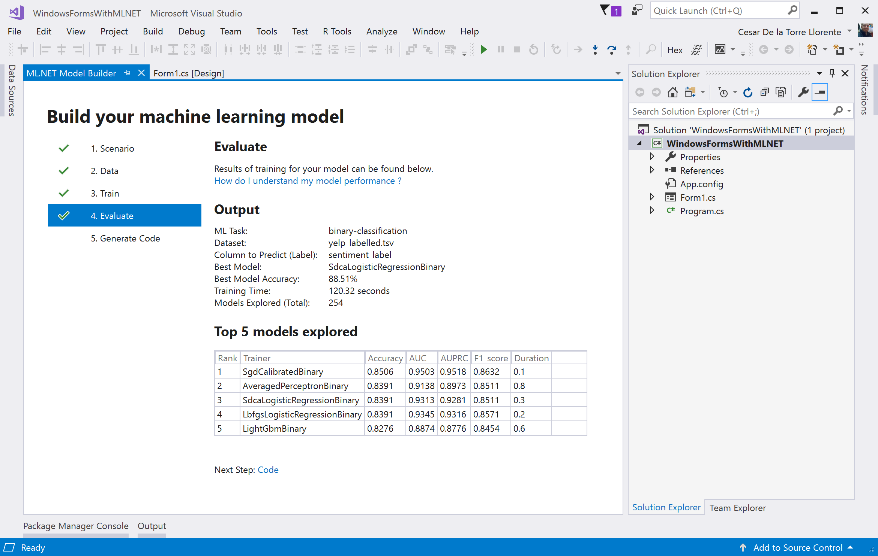
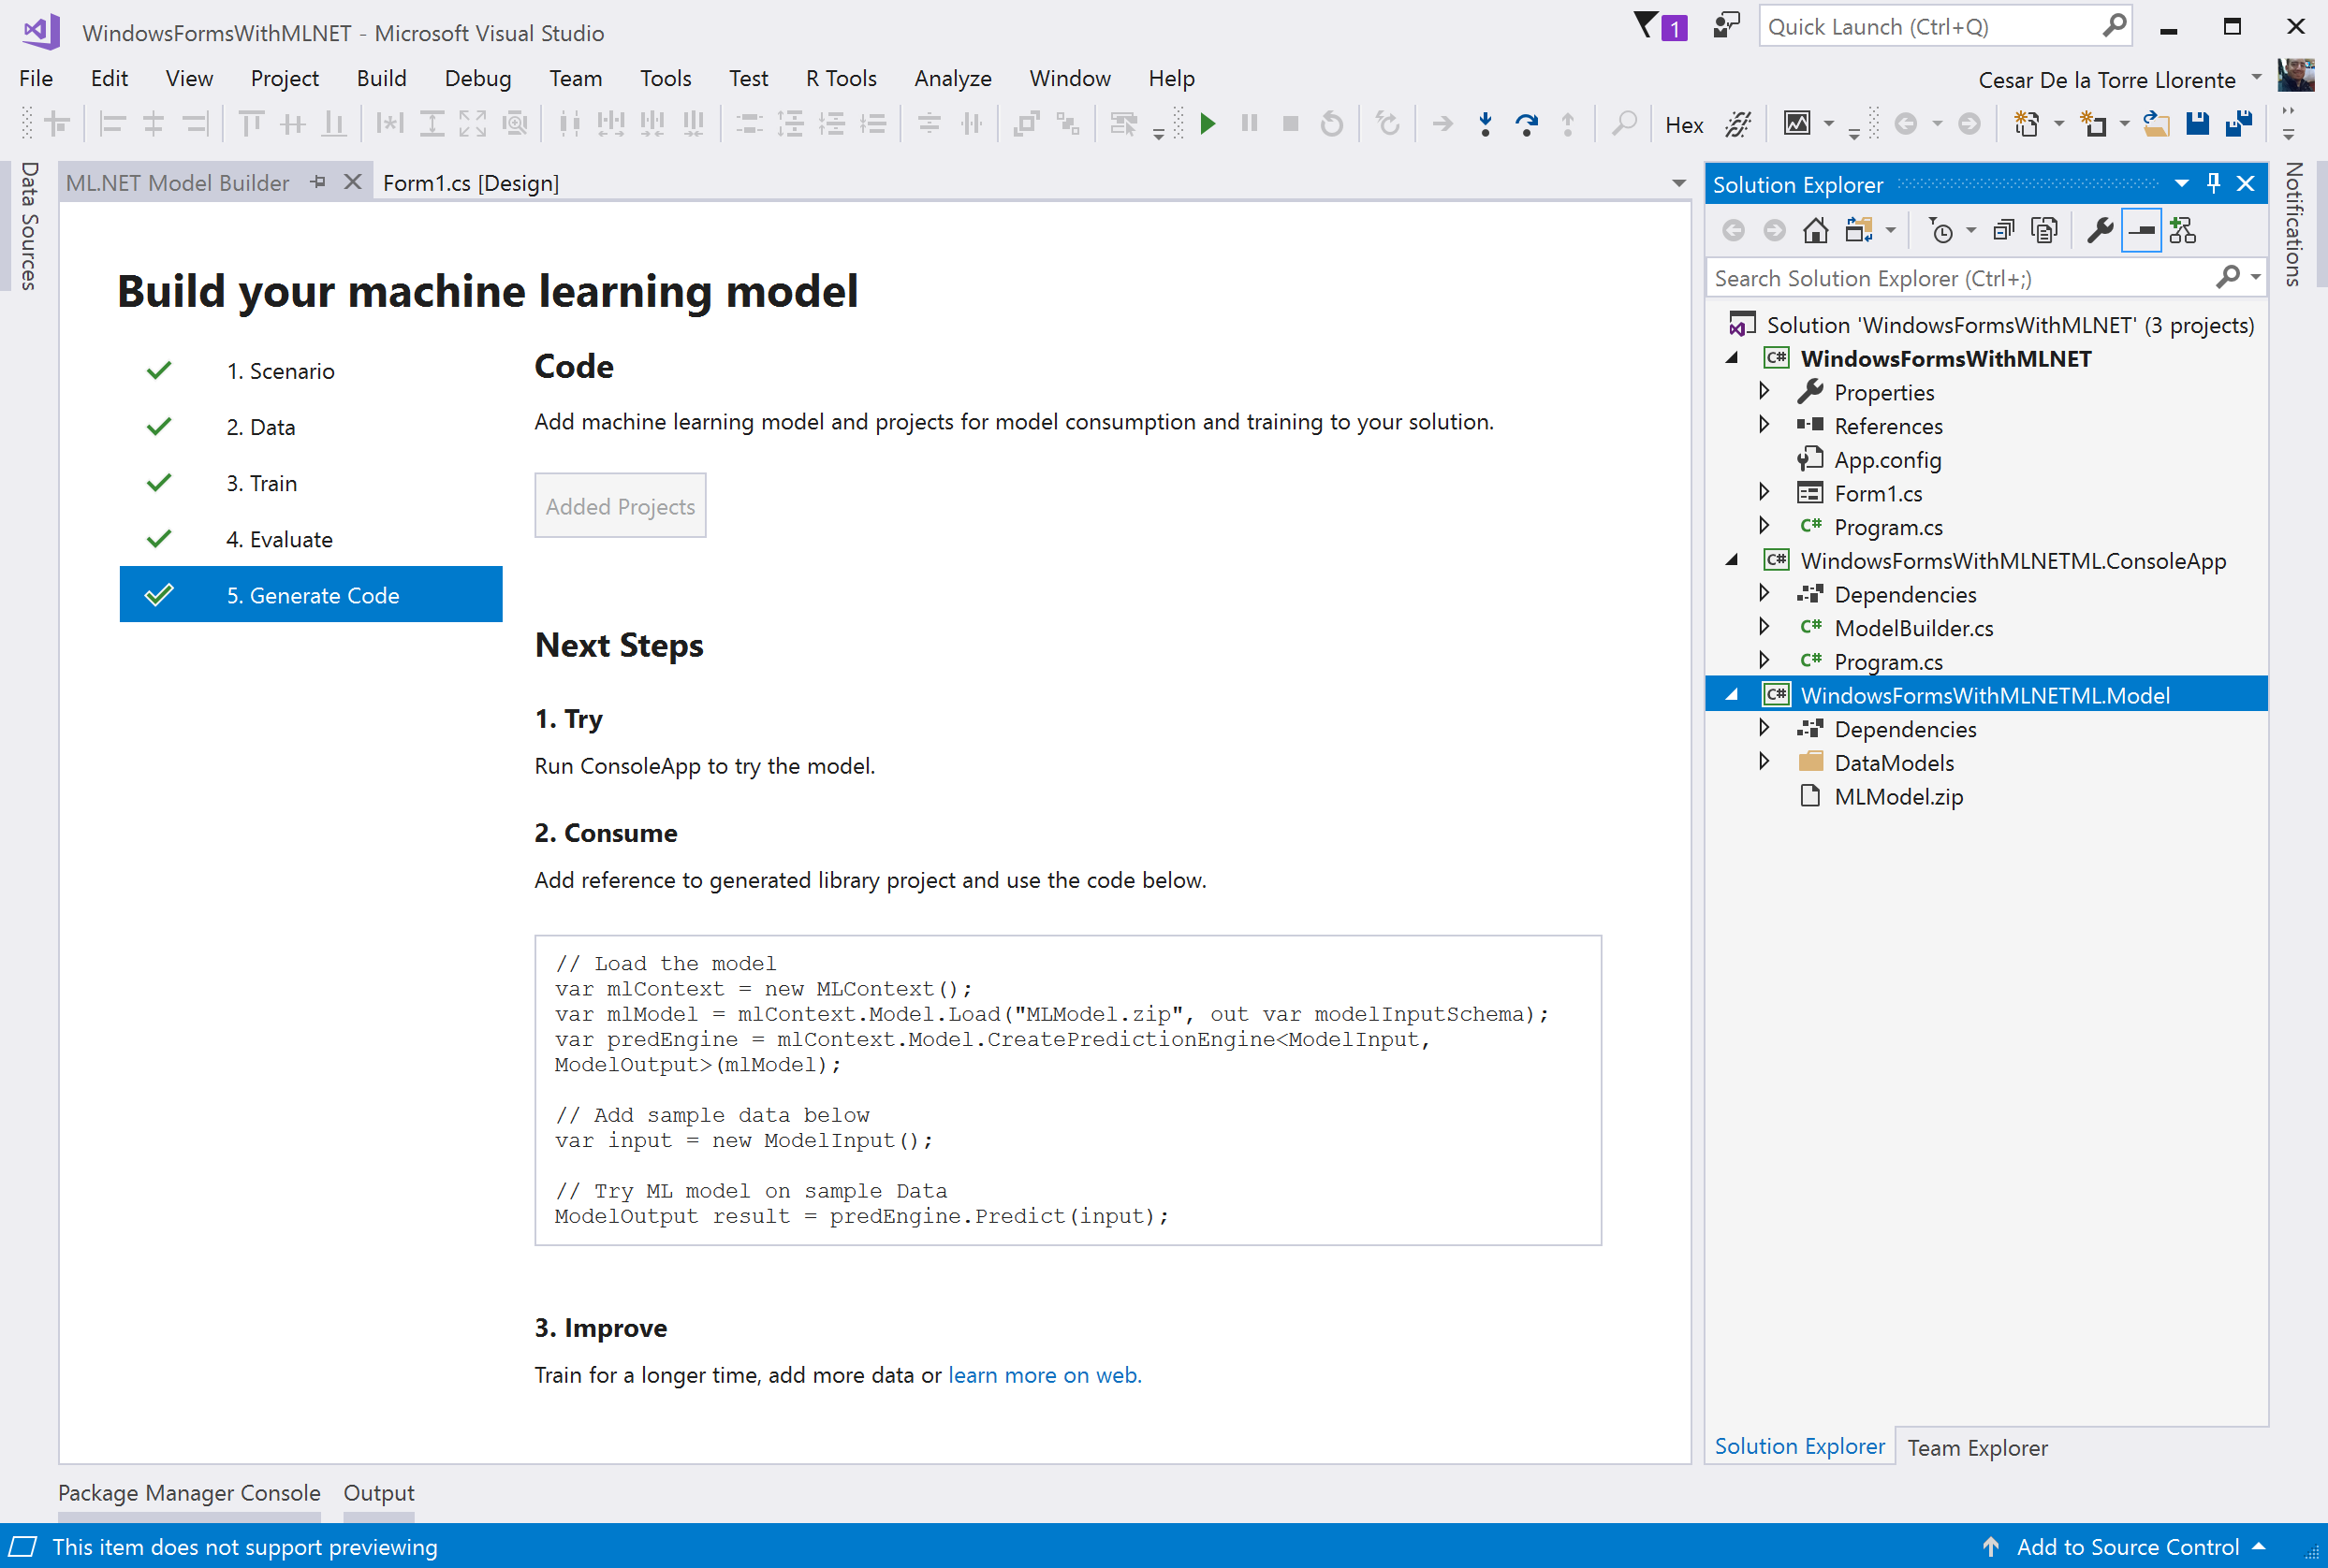
1
2
3
4
5
6

Slide 8

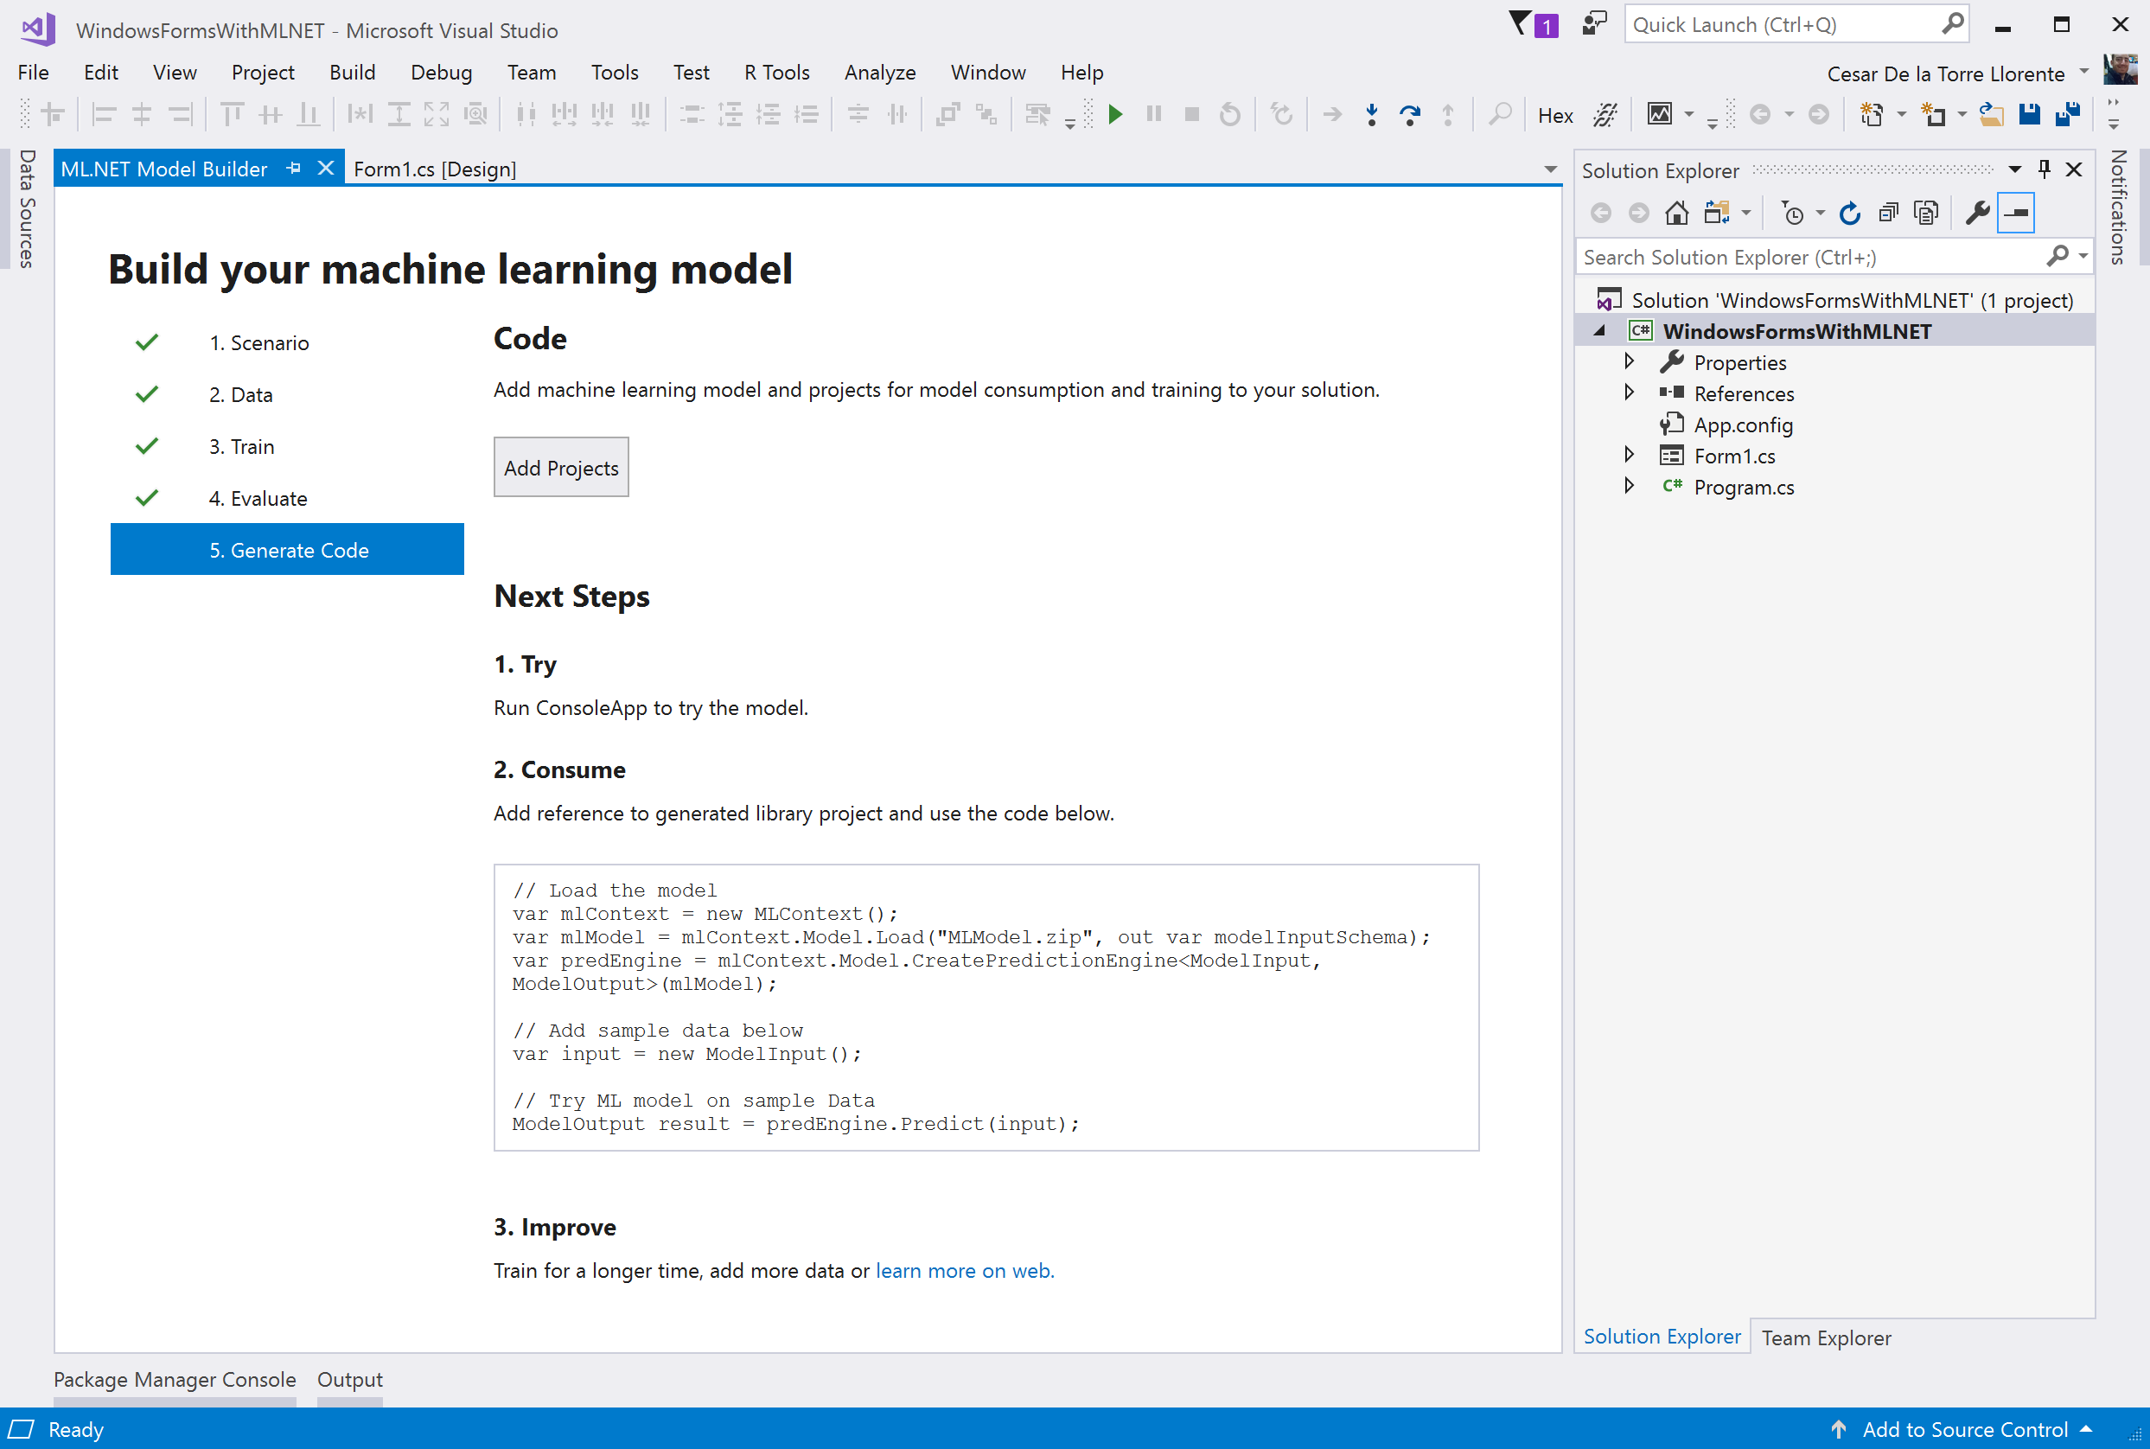

Slide 9
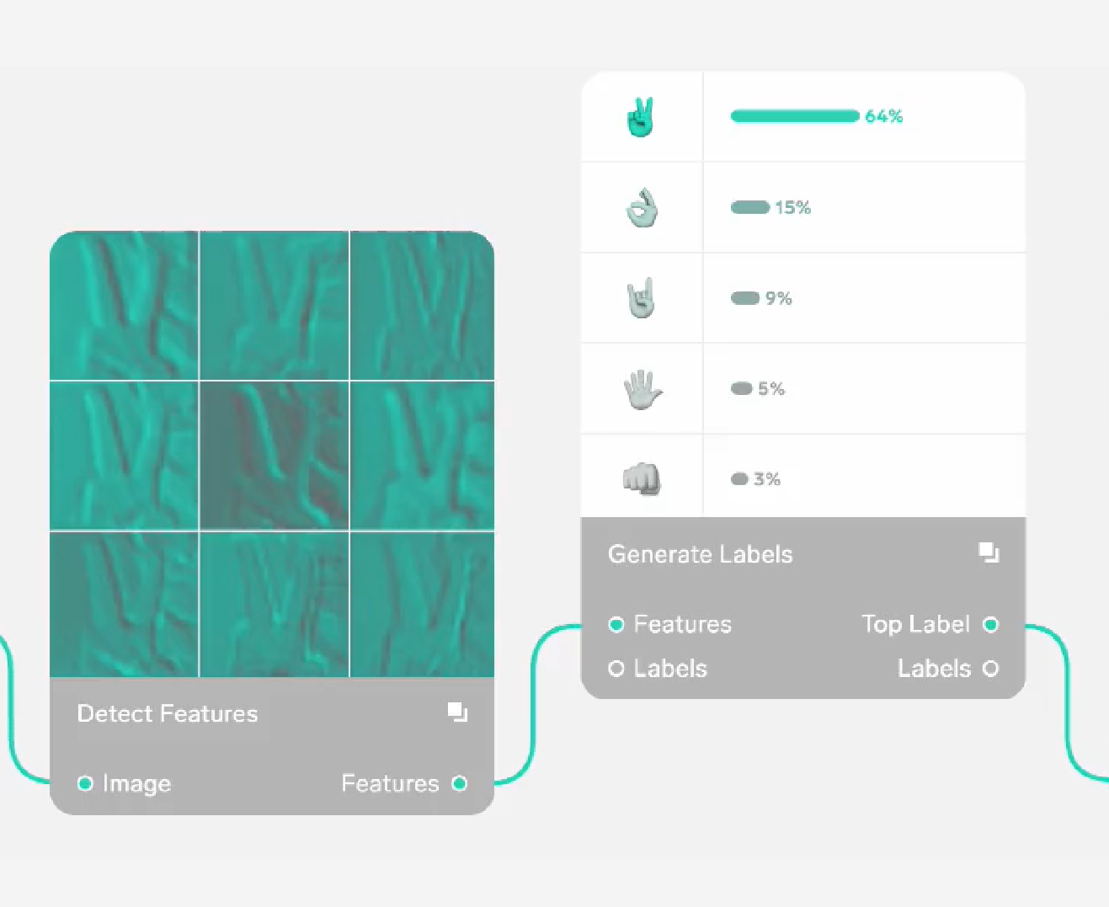
ML.NET CLI and AutoML
API
CLI
UI
C# / F#
ML.NET CLI
UI
Model Builder
on Visual Studio
ML.NET API
IDataView
Trainers
Transforms
AutoML
Deep Learning extensions

Slide 10
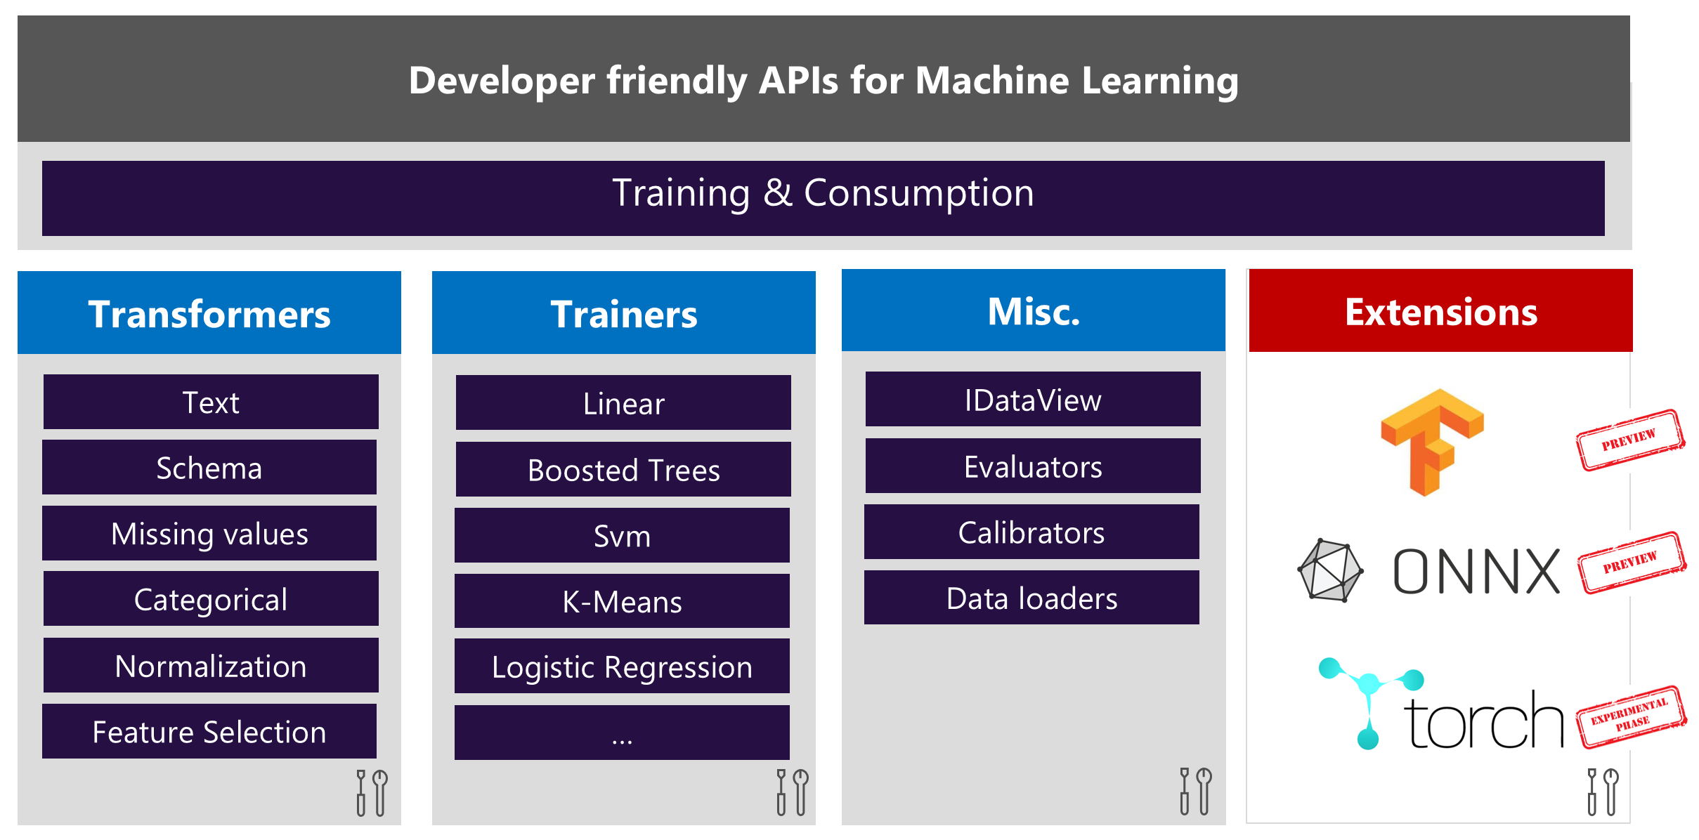

Slide 11
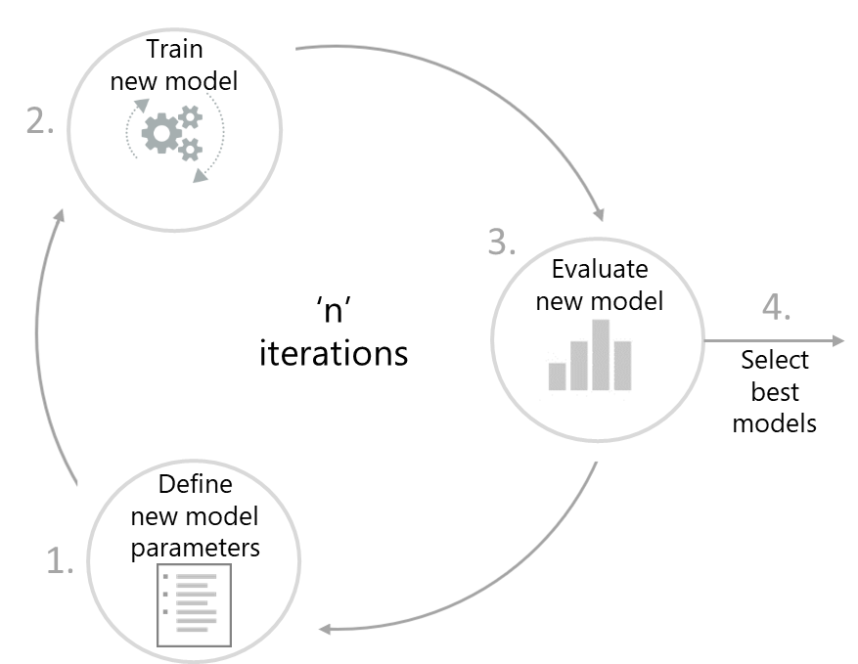


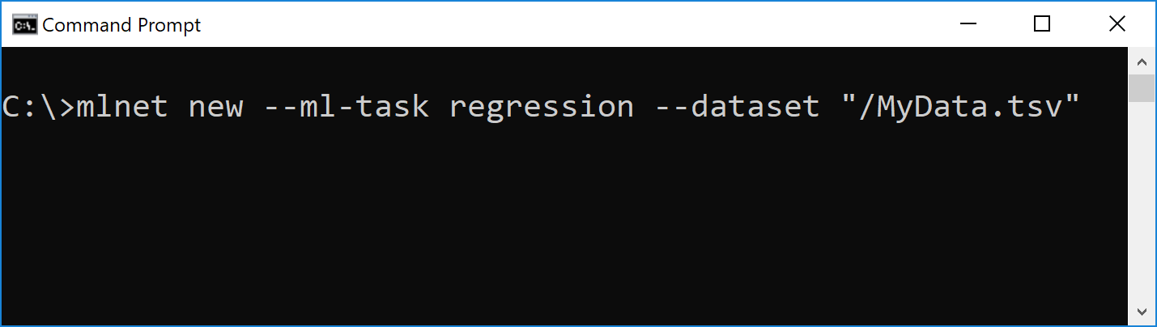

AutoML working inside the ML.NET CLI
ML.NET CLI
produces
‘Best’
ML model/s
.ZIP file/s
Automated
ML experiment
command-line
uses
Best
ML model/s
C#
ML.NET
API code
ML model
scoring code
Developer
CLI (Windows, Mac, Linux)
C# / ML.NET
code generation
C#
ML.NET
API code
“Best”
ML.NET training code
> mlnet new --ml-task binary-classification --dataset "customer-reviews.tsv" --label-column-name Sentiment

Slide 12


The ML.NET journey until v1.0
v0.1 May 2018
v0.2 Jun 2018
v0.3 Jul 2018
v0.4 Aug 2018
v0.5 Sep 2018
v0.6 Oct 2018
v0.7 Nov 2018
v0.8 Dec 2018
v0.9 Jan 2019
v0.10 Feb 2019
v0.11
March 2019
v1.0.0-preview April 2019
ML.NET 1.0 May 2019
GA
1.0
ML.NET 0.1 May 2018
ML.NET 0.2 Jun 2018
ML.NET 0.3 Jul 2018
ML.NET 0.4 Aug 2018
ML.NET 0.5 Sep 2018
ML.NET 0.6 Oct 2018
ML.NET 0.7 Nov 2018
ML.NET 0.8 Dec 2018
ML.NET 0.9 Jan 2019
ML.NET 0.10 Feb 2019
ML.NET 0.11 March 2019
ML.NET 1.0.0-preview April 2019
ML.NET 1.0 May 2019

Slide 13
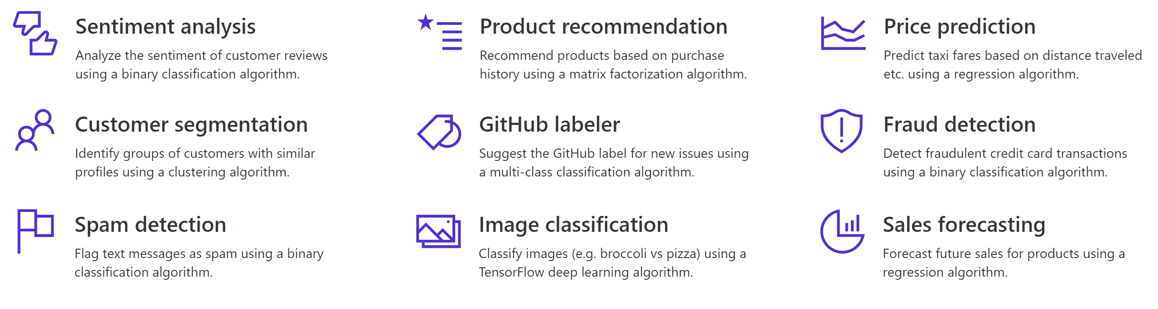

Slide 14
All ML.NET Preview versions before version 1.0
ML.NET 0.1 May 2018
ML.NET 0.2 Jun 2018
ML.NET 0.3 Jul 2018
ML.NET 0.4 Aug 2018
ML.NET 0.5 Sep 2018
ML.NET 0.6 Oct 2018
ML.NET 0.7 Nov 2018
ML.NET 0.8 Dec 2018
ML.NET 0.9 Jan 2019
ML.NET 0.10 Feb 2019
ML.NET 0.11 March 2019
ML.NET
1.0.0-preview April 2019
ML.NET 1.0 RC

Slide 15

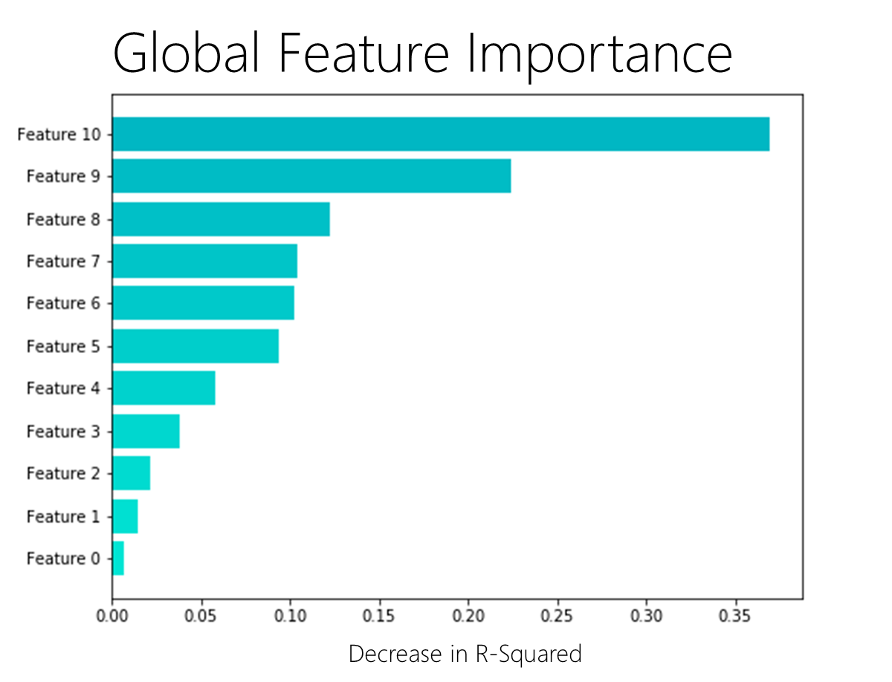
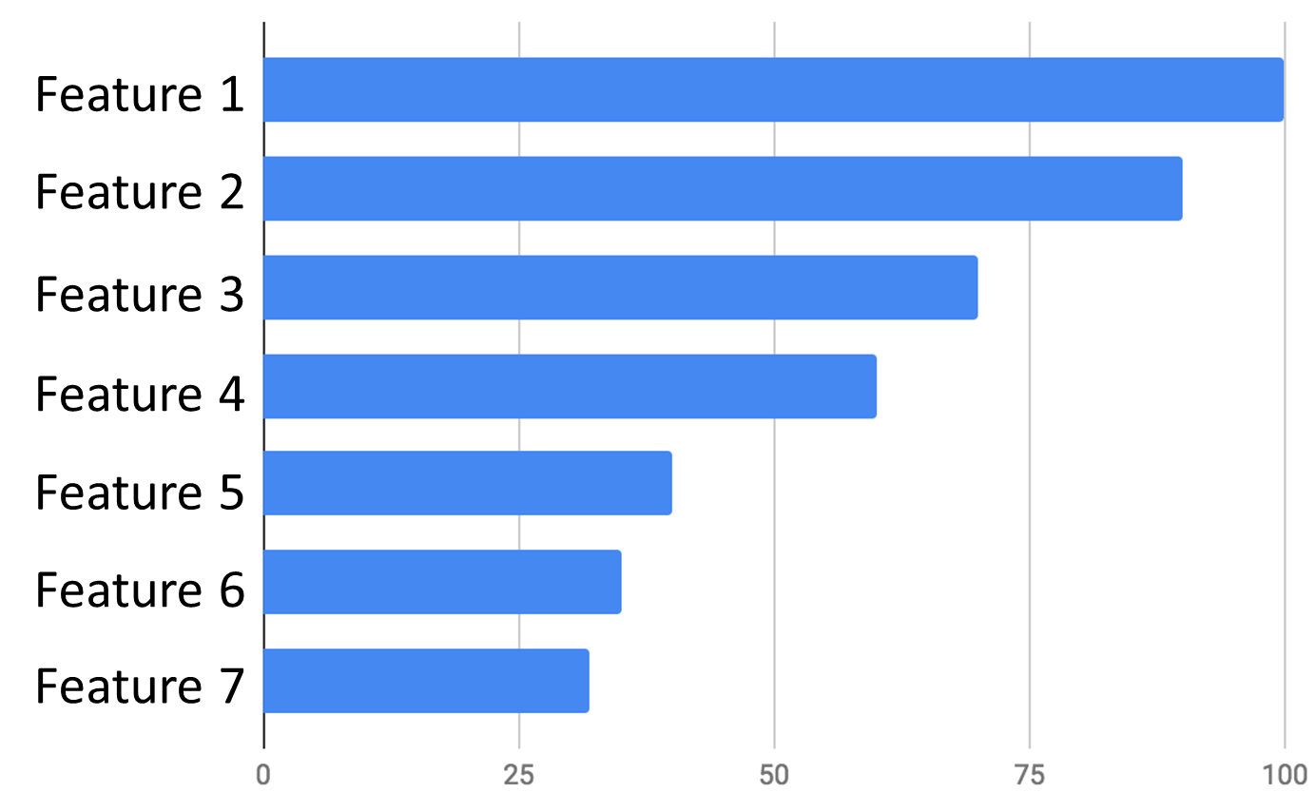







Stateful
Recommendations

Slide 16




Cache

Slide 17
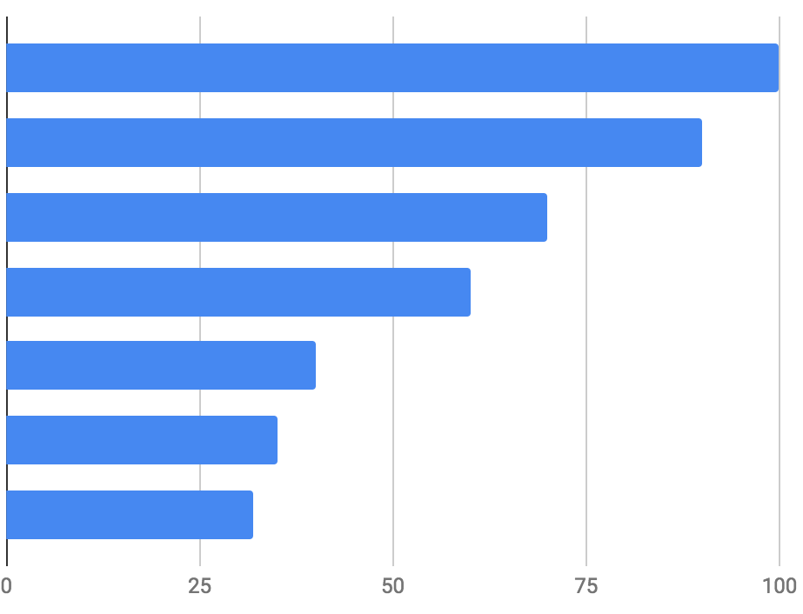
Feature 1
Feature 2
Feature 3
Feature 4
Feature 5
Feature 6
Feature 7
Notes:
Feature 1

Slide 18



ML.NET pipeline
Recommendations
Anomaly Detection
Recommendations

Slide 19
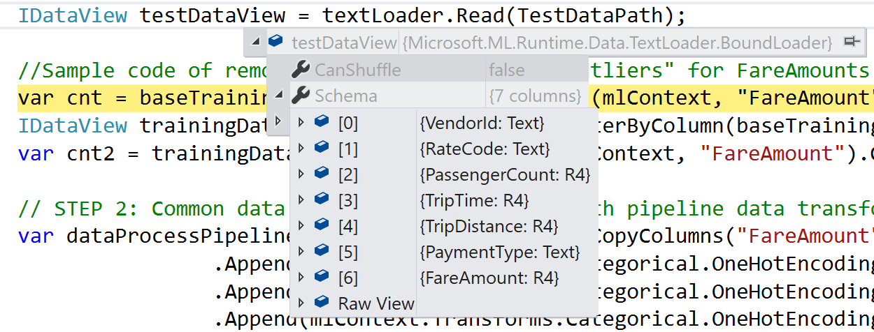
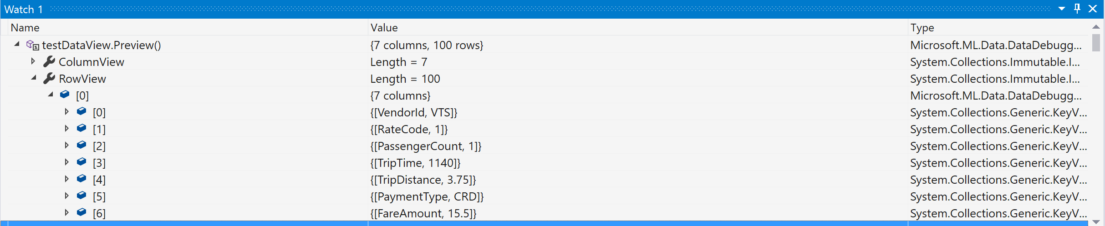
Row’s
Data

Slide 20


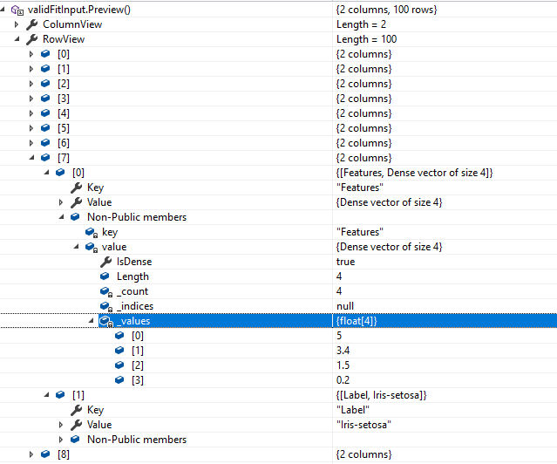
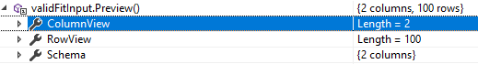
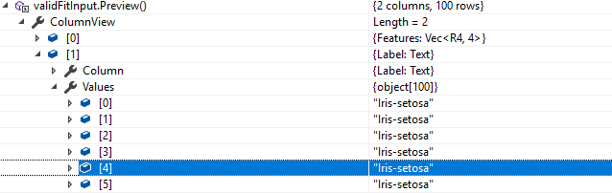
In the case that your dataview you will encounter following message by calling Preview function:
All you need to do is to click on that
icon and Visual studio will execute function in multithreaded environment and produce you object which you can inspect.

Slide 21
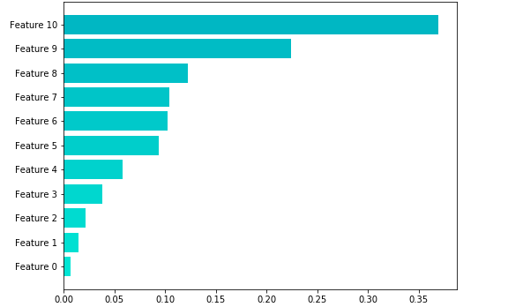
Global Feature Importance
Decrease in R-Squared

Slide 22
